Slide 1
1C:ERP …more than 25 000 projects
1C:ERP is a business solution involving main modules for Enterprise Resource Planning.
While developing 1C:ERP taken into account modern international standards of enterprise management and experience of more than 25000 projects gained in the implementation of "1C" ERP systems.
Solution allows create comprehensive information system according to corporate, Russian and International standards.
Flexible and productive modern "1C:Enterprise 8.3" Platform, supporting the work of the Internet, including "clouds" technologies and mobile devices.
Many solutions that extend the capabilities of the system on a single platform (PDM, MES, EAM, PMO, ITIL, CRM, MDM, WMS, TMS, BSC, ECM, CPM, etc.)

Slide 2
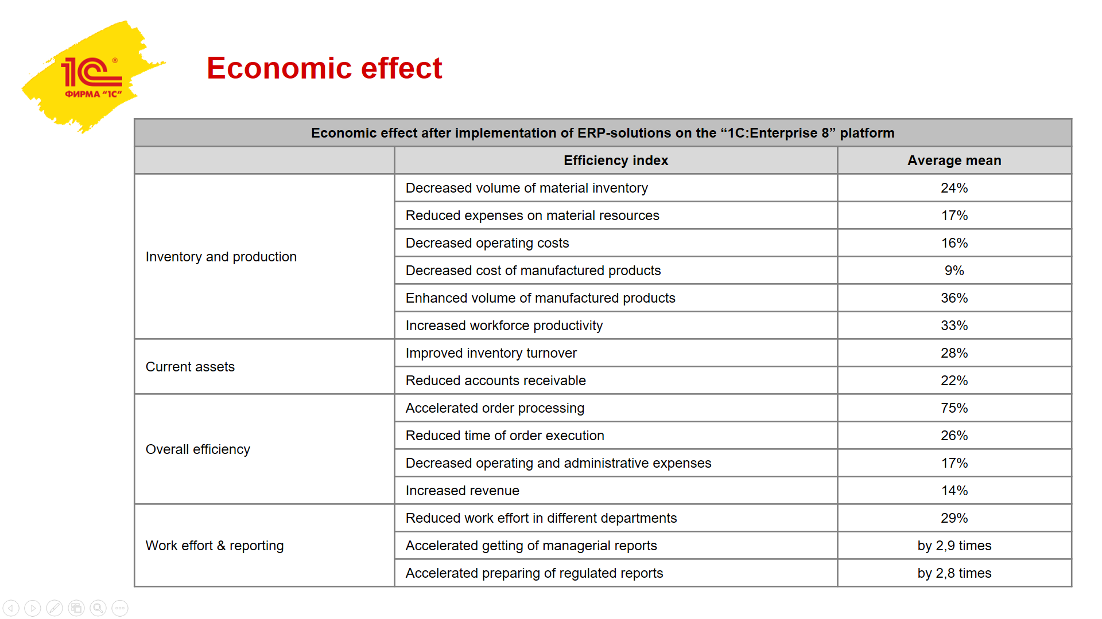
Economic effect
136 published implementation projects with economic indices approved by the clients in 2019

Slide 3
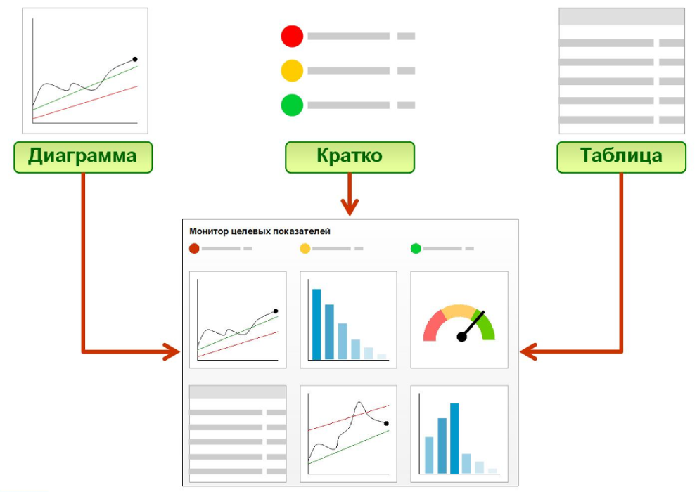
1С:ERP Monitoring and analysis of the company’s performance indices
Creation of a hierarchical model of goals and targets.
Day-Week–Month control principle.
Creation of different options for comparing performance.
Monitoring of targets with explanations of source data.
Advanced analysis of financial results of the business areas.
Great variety of graph formats of analytical reports.
Newsletters on enterprise performance information via email.
Access from mobile devices (tablet, smartphone).
Graphical view
Brief view
Table view
Targets

Slide 4
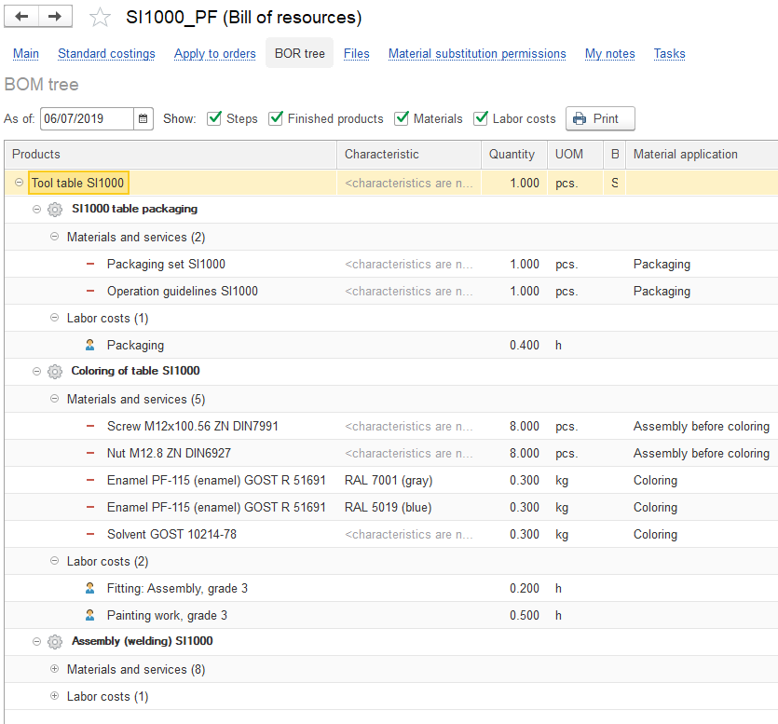
1С:ERP Production management
Visualization of product structures.
Description of production process (resources specifications).
Detailed description of resources needed for production (route sheets).
Support of material, product and semi-finished goods accounting by series.
Parametrical description of needed materials.
Three levels of production planning, consolidation of needs in products, main and local production manager.
Interval planning and Drum–Buffer–Rope.
Bottleneck detection and management.
MES/APS.

Slide 5
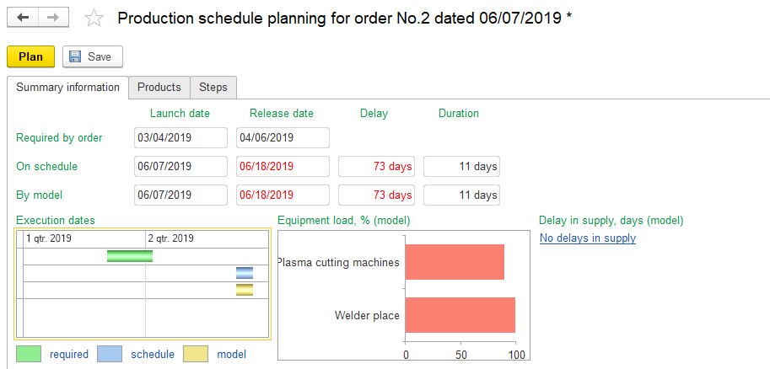
1С:ERP Production management
Order priority management (VIP production orders).
Access estimation of equipment and material resources inside the interval.
Enhanced control of providing production division with resources.
Keeping track of transportation time and monitoring of commodity stocks and supplies.
Production forecasting.
Dispatching control of production on the intershop and intrashop levels.
Flexible replanning.
Improved recording of employees’ efficiency.
Tour tasks:
support of the work in production divisions by turns;
allow to create production operations without route sheets;
enhance the convenience of work with production operations.
Notes:
5

Slide 6
1С:ERP Repair management
Keeping records of repair objects.
Classifying repair objects accordingly to the community factor of passport characteristics, kinds of repair, modes of operation.
Monitoring of condition status of repair objects, аs well as their belonging and location.
Repair objects can be put in other repair objects or be their part.
Repair production and planning of the inventory accordingly to the results of fault detection taking into account probabilities of various outcomes.
In the exploitation process the data about results and detected defects in repair objects appear in the system.
Registration of defects in the journal allows to carry out an analysis and organize execution of planned and eventual repair actions.

Slide 7
1С:ERP Cost management and cost calculation
Allows to organize control over the material flows and consumption of resources that provide manufacturing, managerial and commercial company’s activities.
Expense recording and cost calculation is performed by using the data of operational accounting.
Accounting for the actual costs by business areas at the needed analytical view in volume and value terms.
Operational quantitative resource accounting of work in progress.
Accounting of the actual work in progress at the end of the reporting period at the needed analytics views.
Multiple methods to allocate the cost to products, works, production costs, business areas, future periods.
Actual costs calculation for the period.
The data about the structure of the output cost.
The calculated costs may be detailed to the initial costs regardless of the number of production process stages.

Slide 8
1С:ERP Finance management
Functionalities:
Credits, deposits and loans;
Acquiring (payment cards);
Flexible instruments for keeping the payment calendar;
Analytical reporting of the cash flows;
Postponed displaying of accounting records;
Connecting of accounting records to the documents without transformation;
Creating of documents about typal operations;
Data auditing;
Registration of nonfinancial indices;
Financial reports generator;
Adjusted methodical model: accounts plan, accounting record templates, financial reports in compliance with IFRS;
The documents of operating accounting fix all the business operations, the financial accounting keeps accounting records in compliance with the principles of RAS and IFRS, excluded double data entering.
There is an opportunity to compound some clauses of IFRS reporting by transforming accounting records formed accordingly to the RAS reporting.

Slide 9
1С:ERP Budgeting
Functionalities:
customizable kinds of budget and enlarged analytics;
scenery modeling;
budget process management;
maintenance of various currencies;
table forms for entering and correcting;
economic forecast;
achievement analysis of planned indicators;
summary reporting composition on the basis of monitoring results;
enlarged financial analysis.
Functions for the budgeting managers and specialists:
efficient instruments for the budgeting process management;
data quality control by means of explanation till the initial calculation data;
budget correction management – the history saves any changes in the values of budget items;
convenient calculation of planned indices in the budget editing form – it is possible to use the calculations by formula for each index simultaneously from several data sources;
the versioning option allows to conduct analysis and version comparison.

Slide 10
1С:ERP Customer relationship management
Functionalities:
development of partner relationship strategy;
customer relationship business-processes;
customers’ and partners’ profiles;
loyalty cards, customer loyalty analysis;
claims management;
transaction execution monitoring;
BCG-analysis;
enlarged KPI-analysis of managers.
Functions for the customer relationship managers and specialists:
allows to react rapidly to customers’ requests, to plan relations with them, to estimate results of different marketing and advertising campaigns for attracting clients;
to monitor each appeal;
to use effectively each contact;
to build optimal relationship system by organizing the work with different customer categories;
to monitor cooperation between partners – it is possible to enter the information about all known partner’s business relations and his contact names.

Slide 11
1С:ERP Sales management
Functionalities:
Efficiency management of sales and other transactions with clients;
Sales funnel;
Composition of price lists with information about stock available;
Standardized sales processes, complex sales management;
Enlarged order management, typal and individual sales rules, agreements;
Client self-service;
Commercial agencies management;
Retail trade automation: integration with commercial equipment, product range management, price tag and bar-coded label printing, seasonal planning, loyalty card usage, etc.;
Monitoring of sales process status;
Transport usage planning;
Probability estimate of sales forecast;
Separate accounting of partners (managerial accounting) and counterpart (regulatory accounting);
Automatic control over the debt limits;
Inventory of mutual settlements.

Slide 12
1С:ERP Sales management
Functions for the sales managers and specialists:
allows to fix the history of any negotiations with a customer in respect of sales terms and conditions;
makes it possible to plan revenue gaining on the daily basis, to control the meeting by the client of payment deadlines, to detect expired accounts receivable;
provides through automation of the sales process of goods in the manufacturing plant, in wholesale and retail trade;
involves different instruments for planning and sales control, allows to solve the tasks connected with order management.

Slide 13
1С:ERP Procurement management
Functionalities:
Efficient procurement planning based on the sales and production plans and non-performed orders.
Placing orders to suppliers and control over their execution.
Registration and execution analysis of additional conditions of contracts with fixed nomenclate articles, volumes and delivery time.
Support of various schemes of goods acceptance from suppliers including acceptance for its further sale and getting customer raw materials.
Registering of unbilled deliveries by using warehouse warrants.
Analysis of warehouse and production needs in products, finished goods and materials.
Supply management and order control are performed with necessary detalization (till the order, till the purpose of manufactured product, till the business area).

Slide 14
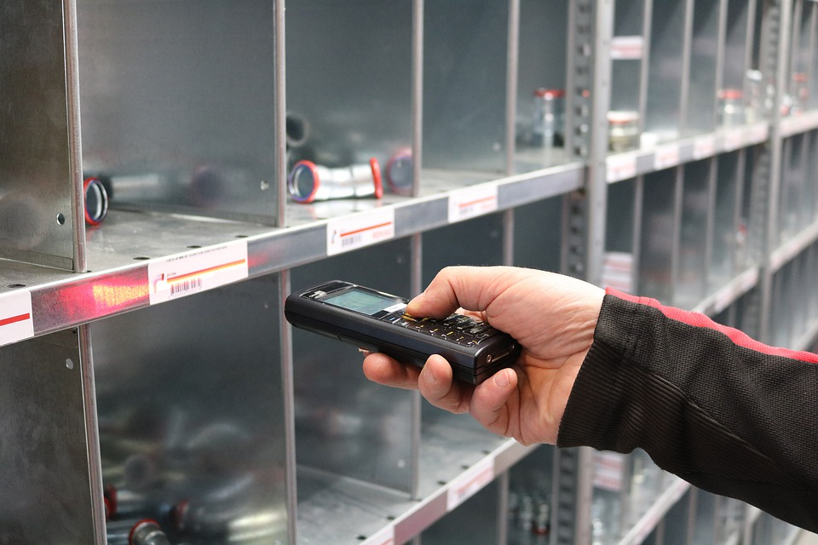
1С:ERP Warehousing and inventory management
Functionalities:
Complicated hierarchical warehouse structure;
Cellular warehouse management;
Separate order recording – needs reservation;
Simplified and enlarged stock maintenance;
Mobile workplaces of warehouse employees;
Multi-turn packaging accounting;
Inventory accounting management;
Management of goods movement between warehouses and plants;
Statistical stock analysis, ABC/XYZ-analysis results keeping;
Forecast demand calculation;
Goods recording in the warehouses accordingly to their series and validity time period;
Delivery management;
Goods calendar.

Slide 15
Current and target infrastructure requirements do not impose limitations for using of 1С:ERP
23 000 employees
5 500 АWP
2 500 employees
1 800 АWP
Maintenance, repair, modernization of locomotive engines
88th position in the ranking «200 largest private companies in the RF» (Forbes), 9 repair factories and more than 80 service train yards
For the year 2018 it was planned to increase the number of workplaces and to launch the block of efficient production management
Supply of great variety of types of rolled metal products.
Manufacturing facilities are able to process 1 million tons of steel annually.
Regulatory accounting, warehousing, planning, production management, repairs, sales.
Partner: AFM-Servers
Partner: EvrazTechnica
3 900 employees
1 300 АWP
1 900 employees
1 200 АWP
The leader among the manufacturers of cabling and wiring products on the territory of the RF and CIS.
More than 200 brands of products and 150 000 label sizes were developed since the company’s foundation.
Planning, production management, sales, marketing, warehousing, finance management
One of the largest telecom service providers in Moscow
The leader among the providers of wide-band cable networks, the largest provider of telecom service in Moscow and Moscow region
Managerial accounting, procurements, warehousing, bookkeeping, tax accounting, integration with 1С:Document management
Partner: Sibkabel
Partner: Absolute-Soft Corporate projects

Slide 16
1С:ERP – small projects
50 employees
5 AWP
45 employees
5 АWP
«Yarus» – an expert in the field of building equipment leasing.
Finance, managerial accounting, indices monitoring, budgeting, CRM, HRM, procurement and document management.
«Samarsky Podshipnik» – a young enterprise that manufactures and supplies pillow blocks of different modifications.
Bookkeeping, tax accounting, regulatory accounting, procurement, sales and production management.
Partner: PromInfoConsult, Samara
Partner: 1С-Rarus Samara, Samara
80 employees
3 АWP
26 employees
5 АWP
«VerRus» – production of dry building mixes.
Bookkeeping, tax accounting, regulatory accounting, payroll, HRM, procurement, sales and production management.
“I-D-B RUS" – wholesale trade of milk products.
Cash flows accounting, bookkeeping under RAS, sales, production, procurement, materials and CRM planning.
Partner: 1С:Perviy BIT, Moscow – the Central office
Partner: Smart ERP Projects

Slide 17
Reasons to choose 1C:ERP instead of analogs
Low cost (of licenses, implementation time, support, TCO)
System’s functionality complies with industrial peculiarities, customers’ needs
Great number of specialists & partners, assistance availability
Integration with other 1C solutions
Implementation and exploitation simplicity, flexibility
High competence, positive experience of collaboration with a partner
Fast adaption to the legislation changes, localization
Deployment rapidness
Expert personnel
Positive repercussions in the industry
Vendor’s reputation and credibility
System’s openness and reliability
«Import substitution»
124
89
71
48
40
32
30
22
19
9
According to the data of partners’ reports (RUS) from January 2015 : 263 choices of ERP-solutions of «1С Company» instead of analogs
7
6
1

Slide 18
Thank you for your attention!

